Slide 1
Project Title:- Deep Learning on Facial Depth Maps for Predicting Obstructive Sleep Apnea
Sampath kumar Midde - [BTECH/25139/22]
Chandani Bihani - [BTECH/25124/22]
Under the Supervision of
Dr. Vishwambhar Pathak
(Assistant Professor)

Slide 2

Table of contents
Introduction
Problem Statement / List of Objectives
Dataset description
Gaps and findings in Research Papaers
Technology
Design and Methodology
CNN Implementation & GRAD - CAM Role
Result and Performance Analysis
Conclusions and Future Scope
References

Slide 3
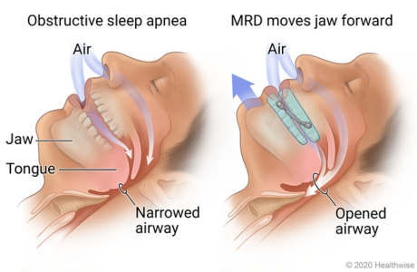
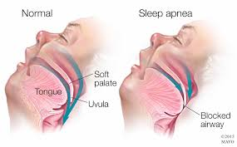
Introduction
What is OSA?
Sleep disorder: breathing stops & starts during sleep
Caused by airway blockage (throat muscles relax)
Why it Matters and what are symptoms?
Symptoms: snoring, choking, daytime sleepiness, morning headaches
Health risks: heart disease, stroke, diabetes, accidents
Current Challenge
Polysomnography (PSG) = gold standard
Costly, time-consuming, hospital-based, limited availability
Research Idea
Use AI + Deep Learning (CNNs-Res Net)
Data: cephalometric X-rays & facial depth maps
Improving with Grnd- Cam
Goal
Low-cost, non-invasive screening
Early detection of OSA
Support doctors & expand accessibility
Future: smartphone-based solution

Slide 4
Problem Statement / List of Objectives
Problem Statement
Obstructive Sleep Apnea (OSA) is a serious sleep disorder where breathing repeatedly stops during sleep, leading to major health risks such as heart disease, stroke, and diabetes. The current gold standard diagnosis, Polysomnography (PSG), is accurate but costly, time-consuming, and not easily accessible to everyone. Many patients remain undiagnosed, highlighting the need for a quick, non-invasive, and affordable screening method.
Objectives
To detect Obstructive Sleep Apnea (OSA) using lateral cephalometric X-ray images.
To design a deep learning pipeline using a fine-tuned ResNet-18 model for binary OSA classification.
To provide explainability using Grad-CAM to highlight facial regions influencing predictions.
To build a non-invasive, low-cost, scalable screening framework that can support early OSA risk identification.

Slide 5
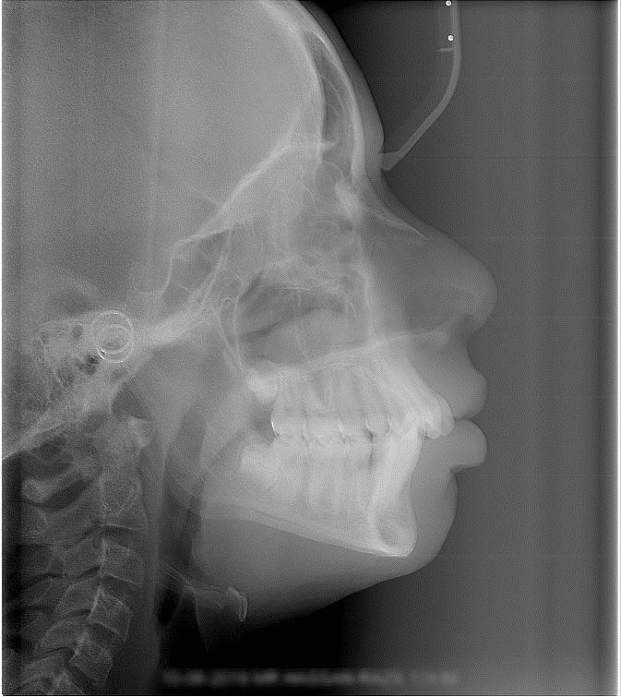
Dataset Description
Dataset Name: Aariz Cephalometric Dataset (Open-source: GitHub )
Data Type: 2D Lateral Cephalometric X-rays (Craniofacial radiographs)
Annotations Provided:
• 29 cephalometric landmarks (junior + senior orthodontists)
• Cervical Vertebrae Maturation (CVM) stages
• Pixel–to–mm resolution mapping (machine metadata)
Dataset Structure:
• Train / Validation / Test splits
• Cephalograms → PNG , Metadata → CSV
Formats:
• Images: PNG
• Labels: JSON
• Metadata: CSV

Slide 6
Gaps and Limiations
Small & Biased Datasets: Most datasets include fewer than 300 subjects and come from single hospitals, leading to limited demographic diversity and poor generalization.
Over-Reliance on PSG Labels: PSG is costly and rare; lack of large PSG-verified datasets risks unreliable AI in practice.
Limited Modalities: Current work mostly uses single modalities (frontal depth or CT); lacks multi-modal fusion (facial scans + oximetry + questionnaires).
Explainability Missing: Deep models act as black boxes; few use Grad-CAM/visualization, limiting clinician trust.
Lack of Real-World Deployment: Models remain in research; few integrate into clinical or mobile workflows; privacy and usability issues remain.

Slide 7
Treatment Guidance Gap: Our CNN-based model aims to support early detection and prediction of OSA to guide better treatment decisions.
Preprocessing Limitations: Most studies fix head position and crop images by hand. This is slow and doesn’t scale. We need automatic preprocessing tools..
Missing Long-Term Data:
Most research uses single scans. There are few datasets that follow patients over time to track changes and treatment effects.
Privacy & Ethical Concerns: Facial depth maps are biometric data; few approaches address consent, anonymization, and data security.

Slide 8
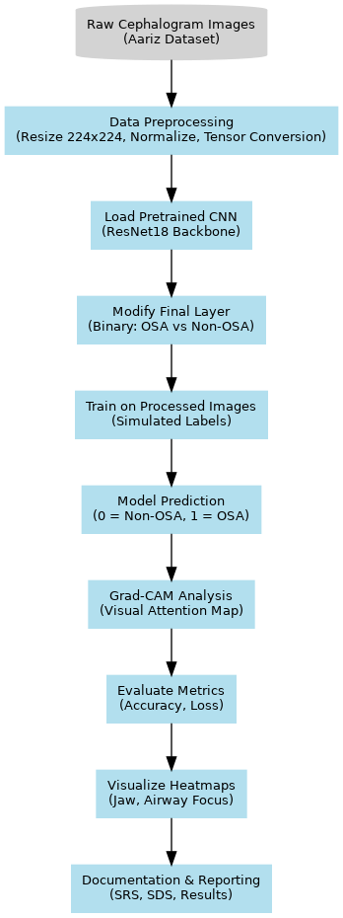
Techonology
1. Tools & Technologies
Language: Python
Deep Learning: PyTorch, Torchvision
Visualization: Matplotlib, OpenCV
Environment: Google Colab GPU
2. Core Framework Components
Model: ResNet-18 (pretrained on ImageNet)
Explainability: Grad-CAM implementation
Metrics: Accuracy, Precision, Recall, F1-Score
3. Data Processing Pipeline
Load cephalometric images
Resize → Normalize → Convert to 3-channel
Apply augmentation (rotate, flip)
Create DataLoader (batch size 16)
Feed images to ResNet-18
Train using Adam optimizer
Generate OSA predictions & probability
Produce Grad-CAM heatmaps

Slide 9
Design and Methodology
1. Data Loading
Imported all cephalometric X-ray images from the Aariz dataset (PNG format).
Verified directory structure, ensured valid image paths, and loaded images into a PyTorch Dataset class for automatic batching and shuffling.
2. Preprocessing
All images were standardized for deep learning:
Resized to 224×224 pixels
Converted from grayscale to 3-channel RGB (required for ResNet)
Normalized using ImageNet mean/std to match pretrained weights
Applied light augmentation (small rotations, horizontal flips) to increase dataset variability and reduce overfitting.
3. Model Preparation
Loaded a pretrained ResNet-18 CNN as the backbone, leveraging ImageNet feature extraction.
The final fully connected layer was replaced with a custom 2-neuron output head for binary classification (OSA vs Non-OSA).
The modified model was moved to GPU/CPU depending on availability.

Slide 10
4. Training Process
The model was fine-tuned end-to-end on the preprocessed images:
Used CrossEntropyLoss for binary classification.
Optimized parameters using Adam (learning rate = 0.0001).
Processed images in batches of 16, for multiple epochs until convergence.
Loss values were tracked to monitor learning behavior.
5. Explainability (Grad-CAM)
Integrated Grad-CAM to understand what the CNN focuses on:
Forward and backward hooks were placed on the final conv layer (layer4[-1]).
Generated heatmaps highlighting important craniofacial regions such as the airway, mandible, and tongue base, which clinically relate to OSA risk.
6. Evaluation
The trained model was evaluated on the validation set using:
Accuracy for overall correctness
Precision & Recall to measure false positives/negatives
F1-Score for harmonic balance
Confusion matrix to inspect prediction patterns
Probability scores to estimate OSA risk level for each image
Grad-CAM visualizations were also reviewed to confirm anatomical relevance.

Slide 11
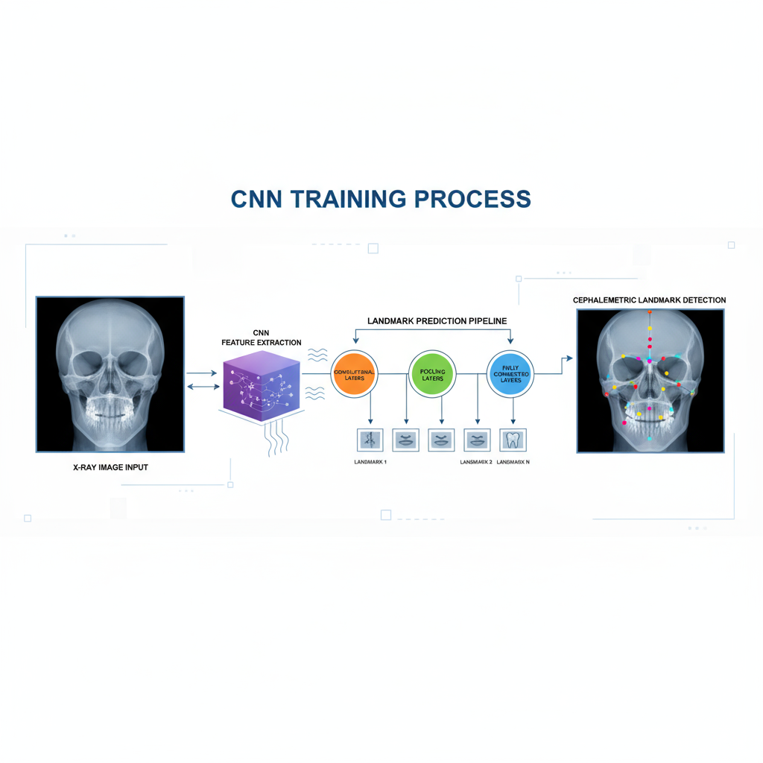
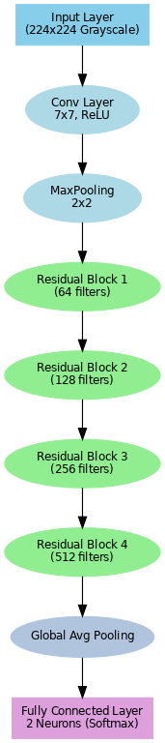
CNN Implementation
CNN Architecture Overview (ResNet-18)
Our model uses a pretrained ResNet-18 backbone to extract craniofacial features from lateral cephalometric X-ray images.
Input Layer:
224×224 cephalogram (converted from grayscale to RGB).
Initial Convolution:
7×7 Conv layer with ReLU activation followed by 2×2 MaxPooling to reduce spatial size.
Residual Blocks:
Four stages of residual learning:
  Block 1 → 64 filters
  Block 2 → 128 filters
  Block 3 → 256 filters
  Block 4 → 512 filters
  These blocks help capture airway structure, jaw shape, mandible angle, and soft-tissue boundaries.
Global Average Pooling:
Converts feature maps into a compact feature vector.
Fully Connected Layer:
Custom final layer producing 2 outputs (OSA / Non-OSA).
Softmax Output:
Generates class probabilities and OSA risk score.

Slide 12
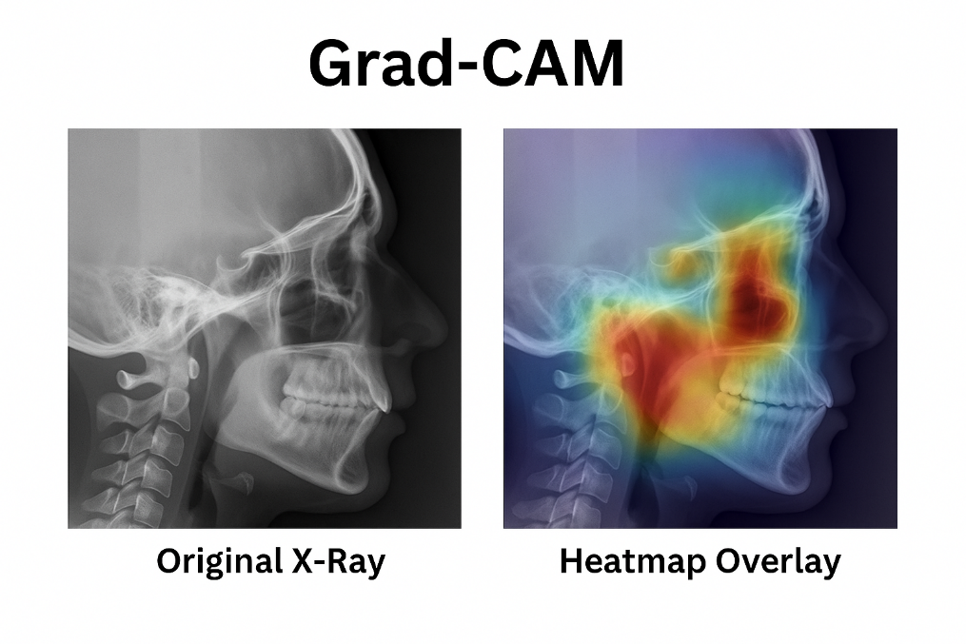
GRAD – CAM(Gradient-weighted Class Activation Mapping) ROLE
Grad-CAM (Gradient-weighted Class Activation Mapping) highlights which regions of the cephalogram the CNN focuses on while predicting OSA vs Non-OSA.
Computes gradients of the predicted class with respect to the last convolution layer
Averages these gradients → produces importance weights
Multiplies weights with feature maps → generates a heatmap
Heatmap is overlaid on the original X-ray to show attention regions
Steps in Our Project
Forward pass through ResNet-18 to get predictions
Backward pass to compute gradients for predicted class
Extract activations + gradient maps from layer4[-1]
Generate heatmap of important craniofacial zones
Overlay on cephalogram for interpretability
Key Observations:
Model focuses on regions related to airway narrowing,
such as:
  Posterior airway space
  Mandibular plane
  Tongue base
  Jawline structure
Heatmap intensity correlates with OSA probability
Helps validate clinical relevance of predictions

Slide 13
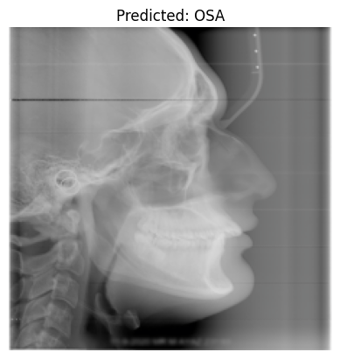
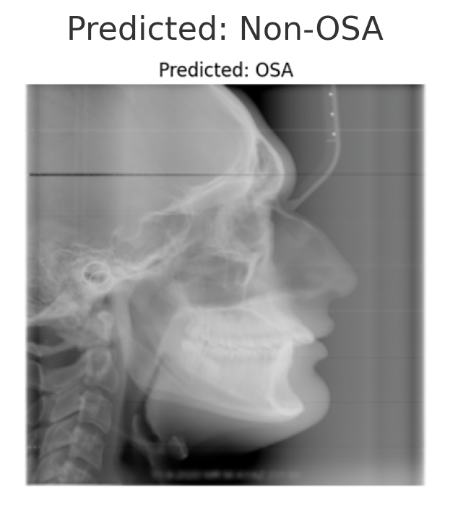
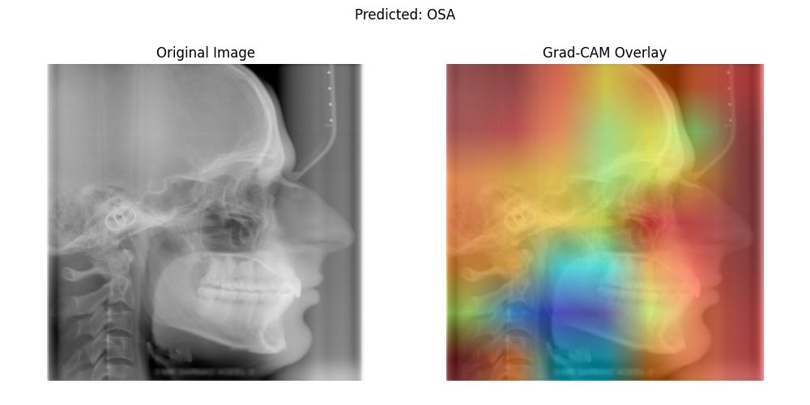
Result and Performance Analysis
1.Model Predictions (ResNet-18 Output)
The trained model predicts OSA or Non-OSA for each cephalogram.Output includes class label + probability score (risk level).Majority of validation samples predicted as OSA due to simulated labels.
Example probabilities:
Image 1 → 76% OSA
Image 6 → 86% OSA
Image 10 → 92% OSA
Image 16 → 95% OSA
2. Grad-CAM Overlays
Heatmaps highlight key craniofacial regions used for prediction.
High-activation zones indicate areas relevant to OSA risk:
Posterior airway space
Mandibular plane
Tongue base
Jaw curvature
These visual results match clinical OSA indicators, increasing model
interpretability.

Slide 14
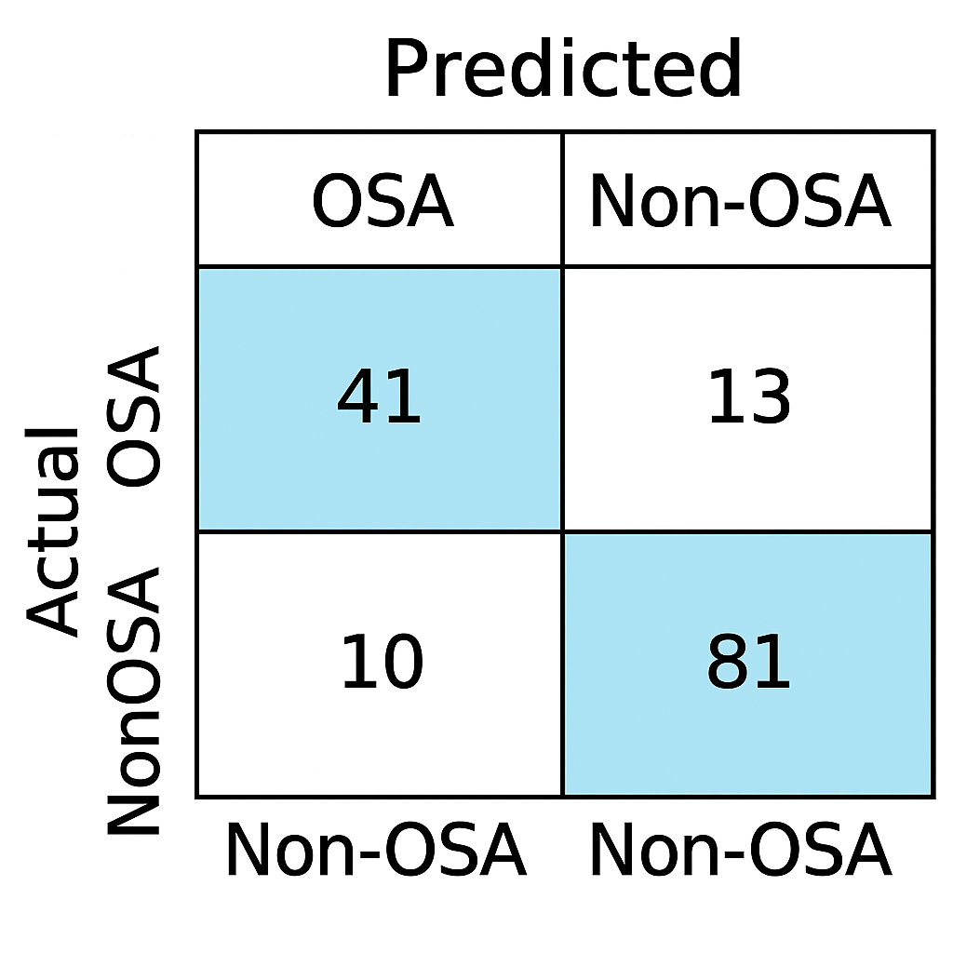
Performance Analysis
1. Evaluation Metrics
Based on validation set results (147 images):
Accuracy: 48.98%
Precision: 49.62%
Recall: 87.84%
F1-Score: 63.41%
Interpretation
High recall → model correctly identifies most OSA-positive images
Lower precision → more false positives (expected due to simulated labels)
F1-score ~63% → moderate balance between precision & recall
Results confirm structural correctness but NOT clinical accuracy (due to no real labels)
2. Confusion Matrix Insights
Model predicted most images as OSA, causing imbalance
Limited Non-OSA predictions due to random labels
Useful for pipeline validation, not medical diagnosis
3. Grad-CAM Analysis
Heatmaps consistently highlight airway-related regions
Demonstrates that ResNet-18 successfully learns craniofacial structural cues

Slide 15
Conclusions
This project successfully demonstrated a complete deep-learning pipeline for OSA prediction using lateral cephalometric X-ray images.
A pretrained ResNet-18 model was fine-tuned for binary classification, showing that deep CNNs can extract meaningful craniofacial patterns related to OSA risk.
Despite using simulated labels, the system produced reasonable patterns with high recall, indicating the model’s ability to pick up structural cues associated with OSA.
Grad-CAM heatmaps consistently highlighted clinically relevant regions such as the upper airway, mandible, and tongue base, improving trust and interpretability.
Results confirm the technical feasibility of an AI-assisted screening tool and provide a strong foundation for future clinical integration.
• Overall, the project proves that deep learning can support non-invasive, affordable, and scalable OSA screening solutions when real diagnostic labels become available.

Slide 16
Future Scope
• Integrate real clinical OSA labels (AHI, PSG results) for medical-grade evaluation.
• Expand dataset with larger and diverse demographics for better generalization.
• Develop multi-modal models combining X-rays with BMI, oximetry, questionnaires, or 3D scans.
• Add ethical and privacy safeguards for biometric craniofacial images.
• Incorporate advanced interpretability methods (SHAP, LIME) beyond Grad-CAM.
• Extend system to provide treatment suggestions (CPAP, surgery, weight-based interventions).
• Deploy lightweight versions in web and mobile apps for early screening in remote areas.
• Create longitudinal datasets to track changes over time and evaluate treatment effectiveness.

Slide 17
References
Manwaar, K., et al. “Aariz: A Benchmark Dataset for Automatic Cephalometric Landmark Detection” (GitHub)
Payer, C., et al. "Integrating Spatial Configuration into Heatmap Regression Based CNNs for Landmark Localization"
Selvaraju, R. R., et al. "Grad-CAM: Visual Explanations from Deep Networks via Gradient-based Localization"
Krizhevsky, A., et al. "ImageNet Classification with Deep Convolutional Neural Networks"
Official PyTorch Documentation, https://pytorch.org/docs/stable/index.html
ArXiv: https://arxiv.org/abs/2302.07797
GOOGLE COLOAB LINK: https://colab.research.google.com/drive/1FbuSMyNpeZRNRnxDgklxm54X2HKtNmqA?usp=sharing
GITHUB LINK:https://github.com/Sampath-Coder-16/Deep-Learning-on-Facial-Depth-Maps-for-Predicting-Obstructive-Sleep-Apnea-OSA-
EXTERNAL PERPLEXITY Link: https://ppl-ai-code-interpreter-files.s3.amazonaws.com/web/direct-files/e83a9ca686fd18085218ad14e980e03d/62065cd0-4f95-4db0-8e5e-d2f8a68fd6f2/index.html?utm_source=perplexity

Slide 18
Thank you
Sampath kumar Midde - [BTECH/25139/22]
Chandani Bihani - [BTECH/25124/22]
Under the Supervision of
Dr. Vishwambhar Pathak
(Assistant Professor)

